Slide 1
CORE-V MCU UVM Environment Project Proposal
David Poulin - Datum Technology Corporation
dpoulin@datumtc.ca

Slide 2
High Level Summary
Create industrial-grade UVM Verification Environment for core-v-mcu
Attract existing, new and potential members of OHWG to participate in development
Follow verification process established by core-v-verif, including:
Verification plans
SystemVerilog and UVM

Slide 3
Industry Landscape
No real competing product/project in the open source community.
Comparable in the commercial space are:
Arm® Cortex®-M0+ by ST Micro from the STM32L0 Series.

Slide 4
Known Project/Market Requirements
Develop extensible UVM verification environment able to perform software-driven verification
Able to replace the RISC-V core with UVM agents to run stimulus
Capable of running full verification of peripherals
Ability to simulate and synthesize in Xilinx Vivado

Slide 5
Project Details
Who would make use of this?
Companies & academic organizations wanting to create their own intermediate-scale, single core SoC/micro-controller
Estimate of Timeline
6-9 months, depending on number of participants
Why OpenHW should do this project?
CORE-V MCU would be the world's first, ready-to-implement TRL-5 F&OS SoC
First RISC-V SoC UVM Environment runnable on a “free” simulator

Slide 6
More Project Details
OpenHW Members/Participants committed to participate
Datum Technology Corporation (DTC)
Project Manager
David Poulin - DTC

Slide 7
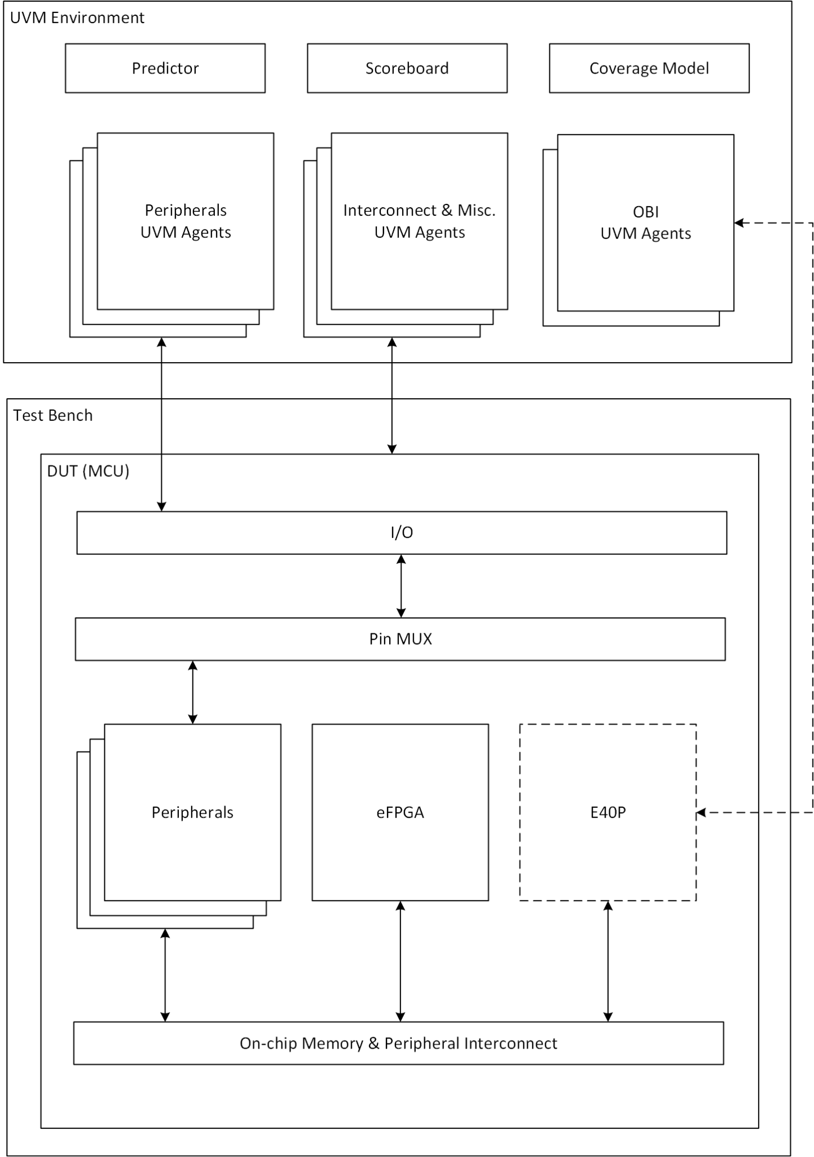
Technical Overview

Slide 8
Potential future enhancements
Ability to verify the embedded FPGA
Ability to support integration of new peripherals

Slide 9
Next Steps
Get MCU stood up in a UVM Environment+Test bench in Vivado with RISC-V core
Stub out the cv32e40p and replace with OBI Agents
Re-create the ability to run the existing CORE-V MCU test suite with coverage enabled

Slide 10
Thank you for your time
Questions?
Contact me via email: dpoulin@datumtc.ca
Markdown version of project proposal also available on demand!

